Slide 1

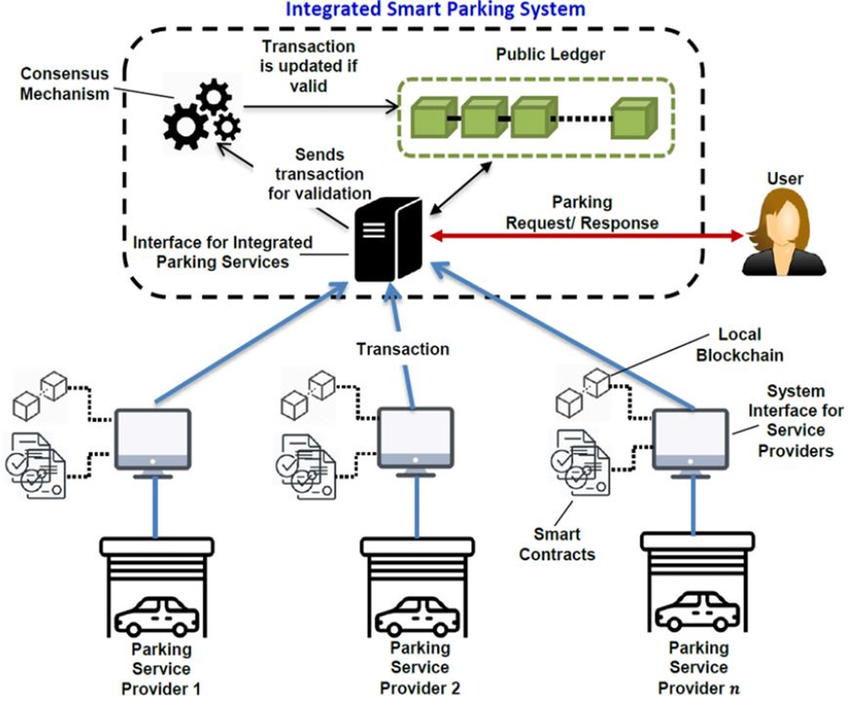
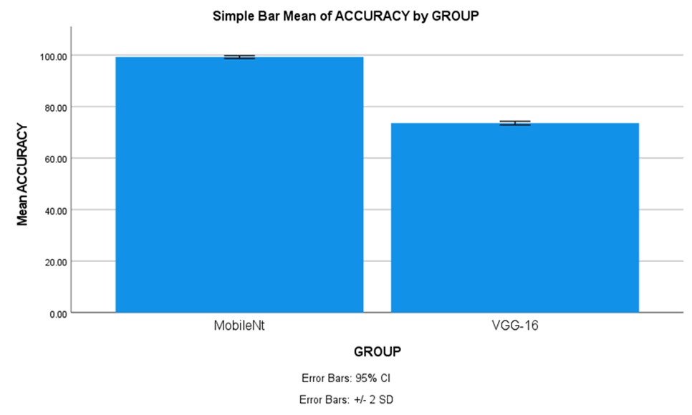
Name: N.S Lakshmi Charith Register Number: 192111138
Guided by Dr. S.Sankar
Ms. Poorani.S
Guided by Dr. Mary Valantina. G
Efficient Smart Parking System Using VGG-16 Algorithm Comparing with MobileNet-V2 Algorithm
INTRODUCTION
As cities continue to grow and face challenges of congestion and pollution, efficient smart parking solutions become imperative for creating smarter, more sustainable urban environments.
The aim of this study is to classify real-time processing and decision-making, ensuring quick and accurate identification of available parking spaces by using two deep learning algorithms.
In this research study, MobileNetV-2 algorithm is compared with VGG-16 algorithm to enhance accuracy. MobileNet-V2 has a more straightforward architecture with stacked convolutional layers, better suited for capturing the visual features of the parking spots. VGG-16 is generally known in the field of computer vision due to its simplicity and effectiveness in various image classification tasks.
The research will employ a diverse dataset of car parking images encompassing various spaces to evaluate the effectiveness of car parking identification algorithms.
The advantage of MobileNet-V2 algorithm is having higher accuracy when compared with VGG-16 algorithm.
MATERIALS AND METHODS
The Research work is carried out MobileNet-V2 Algorithm is in Group 1 and Group 2 is compared of VGG-16t algorithm. The sample size is given to each group 10 times.
Alpha, Beta, G-Power, CI and threshold values for the study are 0.05, 0.2, 0.8 and 95% respectively.
The Dataset is Made up of Images, there were 5000 images in this particular dataset. The dataset includes details of occupied and un occupied parking spaces and different size of vehicles.
A testing setup called both hardware and software configurations with windows compatibility.
SPSS tool is used for calculating t-test values. Independent and dependent variables were considered.
System Initialization
Acquiring Reference Image
Image Enhancement
Identifying Parking Space
Checks Availability
Acquiring Image (with Cars)
Coordinates Parking Area
Display Output
RESULTS
The MobileNet-V2 algorithm accuracy is 97% and accuracy for VGG-16 algorithm is 73.70%.
The Mean accuracy of the MobileNet-V2 algorithm is 97%, with a standard deviation of 0.30%. For VGG-16, the mean accuracy and standard deviation are 73.55% and 0.45 respectively.
Group |  | N | Mean | Standard Deviation | Standard Error Mean
Accuracy rate | MobileNetv | 10 | 97.4500 | .30277 | .09574
 | VGG-16 | 10 | 73.4500 | .30277 | .09574
DISCUSSION AND CONCLUSION
Based on obtained results, MobileNet-V2 has significantly better accuracy (97%) compared to VGG-16 Algorithm accuracy (73.55%).
The Independent samples T-test revealed a statistically significant difference value of (p=0.013) (independent sample T - test p<0.05) is obtained and shows that there is a statistical significant difference between the group 1 and group 2.
In this study, the main contributors are vehicles and parking spaces. The MobileNet-V2 algorithm demonstrates an accuracy rate of 97%, outperforming VGG-16, which achieves 73% accuracy. This findings revealed that MobileNet-V2 achieved higher accuracy in classifying images compared to VGG-16 algorithm.
This research has identified that smart parking is evolving from simply finding an empty spot to navigate cities, and managing our resources with efficiency and sustainability with advancements in automation and vehicle integration.
From the work , it is concluded that the MobileNet-V2 algorithm attains high accuracy. MobileNet-V2’s ability to run efficiently on devices with good accuracy makes it a strong foundation for future advancements in embedded applications, medical diagnosis and wearable tech.
BIBLIOGRAPHY
Iqbal, Ifraham, Mazharul Islam Leon, Nilambar Haldar Tonmoy, Jahidul Islam, and Amit Ghosh. 2021. “Deep Learning Based Smart Parking for a Metropolitan Area.” In 2021 IEEE Region 10 Symposium (TENSYMP). IEEE. https://doi.org/10.1109/tensymp52854.2021.9550904.
Farley, Albertus, Hanry Ham, and Hendra. 2021. “Real Time IP Camera Parking Occupancy Detection Using Deep Learning.” Procedia Computer Science 179: 606–14.
Kumar, Kamlesh, Vijander Singh, Linesh Raja, and Swami Nisha Bhagirath. 2023. “A Review of Parking Slot Types and Their Detection Techniques for Smart Cities.” Smart Cities 6 (5): 2639–60.
Padmasiri, Heshan, Ranika Madurawe, Chamath Abeysinghe, and Dulani Meedeniya. 2020. “Automated Vehicle Parking Occupancy Detection in Real-Time.” In 2020 Moratuwa Engineering Research Conference (MERCon). IEEE. https://doi.org/10.1109/mercon50084.2020.9185199.
Tammina, Srikanth. 2019. “Transfer Learning Using VGG-16 with Deep Convolutional Neural Network for Classifying Images.” Mathematical Sciences Research Journal. An International Journal of Rapid Publication 9 (10): 9420.

